Slide 1
Bachelor of Science (Honours) in Data Science and Artificial Intelligence
DA110: Data Structure
Optional Note: Usage of this material for teaching and education is considered fair use. However, if that includes posting images to a website, or commercial usage that could be considered copyright infringement. In such case, you are required to reach out to the author(s) or the Institute for permission before the usage.

Slide 2
Bachelor of Science (Honours) in Data Science and Artificial Intelligence
DA110: Data Structure
Optional Note: Usage of this material for teaching and education is considered fair use. However, if that includes posting images to a website, or commercial usage that could be considered copyright infringement. In such case, you are required to reach out to the author(s) or the Institute for permission before the usage.
Notes:
Hello Welcome to Data Structure Course
My name is Sanasam Ranbir Singh
I am a professor in the department of Computer Science and Engineering
And, also associated with Mehta School of Data Science and Artificial Intelligence at IIT Guwahati

Slide 3
Bachelor of Science (Honours) in Data Science and Artificial Intelligence
DA110: Data Structure
Optional Note: Usage of this material for teaching and education is considered fair use. However, if that includes posting images to a website, or commercial usage that could be considered copyright infringement. In such case, you are required to reach out to the author(s) or the Institute for permission before the usage.
Notes:
In this course, we will learn different types of data structures, different operations that can be applied on them, implementation of these operations
We will also explore various applications of data structures for solving various real world problems.

Slide 4
Bachelor of Science (Honours) in Data Science and Artificial Intelligence
DA110: Data Structure
Optional Note: Usage of this material for teaching and education is considered fair use. However, if that includes posting images to a website, or commercial usage that could be considered copyright infringement. In such case, you are required to reach out to the author(s) or the Institute for permission before the usage.
Notes:
Why you need to learn data structure?
You imagine any real world problem, say weather forecasting.
You need to refer to historical data, weather reports of past many years.

Slide 5
Bachelor of Science (Honours) in Data Science and Artificial Intelligence
DA110: Data Structure
Optional Note: Usage of this material for teaching and education is considered fair use. However, if that includes posting images to a website, or commercial usage that could be considered copyright infringement. In such case, you are required to reach out to the author(s) or the Institute for permission before the usage.
Notes:
Data Structures and algorithms go hand in hand while solving a problem.
Data structure deals with storing of underlying data needed for solving the problem in computer’s memory so that it can be accessed efficiently.
Whereas algorithm focuses on the procedures or steps involved in solving the problem.

Slide 6
Bachelor of Science (Honours) in Data Science and Artificial Intelligence
DA110: Data Structure
Optional Note: Usage of this material for teaching and education is considered fair use. However, if that includes posting images to a website, or commercial usage that could be considered copyright infringement. In such case, you are required to reach out to the author(s) or the Institute for permission before the usage.
Notes:
For a given problem, many algorithms can be applied. Like wise, different data structures can be used to store the data.
For a given problem, one needs to know, which algorithm to choose,
and for a chosen algorithm one needs to know, which data structure to use, for an efficient solution.

Slide 7
Bachelor of Science (Honours) in Data Science and Artificial Intelligence
DA110: Data Structure
Optional Note: Usage of this material for teaching and education is considered fair use. However, if that includes posting images to a website, or commercial usage that could be considered copyright infringement. In such case, you are required to reach out to the author(s) or the Institute for permission before the usage.
Notes:
This course will focus on data structure, and you will learn algorithm in another course.
At the end of this course, one should be able to decide which data structure to be chosen for a given algorithm.
How to implement the data structures and their operations?

Slide 8
Bachelor of Science (Honours) in Data Science and Artificial Intelligence
DA110: Data Structure
Optional Note: Usage of this material for teaching and education is considered fair use. However, if that includes posting images to a website, or commercial usage that could be considered copyright infringement. In such case, you are required to reach out to the author(s) or the Institute for permission before the usage.
Notes:
I will be using C programming language to explain implementation of various data structures and their operations.
Hope you enjoy this course, and wish you a great learning experience.

Slide 10
Week 1
Introduction to Data Structures
Notes:
Hello, Welcome back
In this week, I will briefly introduce the topic of data structure, and
At the end of this week, you will learn

Slide 11
Learning Objectives
01
What is a data structure?
02
What is an algorithm?
03
Basic terminologies
04
Classification of data structures
05
Array data structure
06
Abstract Data Type

Slide 12
Let us begin with two questions
What is a Data Structure?
What is an Algorithm?

Slide 13
A data structure defines a data collection of data values, logical relationship among them, the operations that can be applied on the data.
An algorithm is a well-defined list of finite unambiguous steps for solving a problem.
Notes:
These are the complex definitions that you will find in books
Do not worry. Let us try to understand these terms with a toy example.

Slide 14





The task is to arrange them so that you can systematically search the collection and locate a book.
You have a collection of books
Notes:
Let us say, you have a collection of books placed very unorganized. And the task….

Slide 15
Scenario I
1
2
3
4
5
Notes:
You have series of book holders placed one after another numbered as 1st, 2nd 3rd and so on … as shown in the figure.
And let us say, you want to place the books in these book holders one after another in this manner
First book in the first holder, second book in the second holder, and so on… as shown in this animation

Slide 16
Scenario I
1
2
3
4
5
Notes:
You can see that these book holders have no dependency and we can use them in any manner we want. SO I can also place the books in arbitrary manner without following any order, like this.
First book in 2nd place, 2nd book in 4th place, 3rd book in 1st place and so on…

Slide 17
Scenario I
1
2
3
4
5
Notes:
we have organized the collection in this linear arrangement.
Now, If we want to remove the books from this arrangement, We can also remove in any arbitrary manner without any condition on others.

Slide 18
Scenario I
Random Access
1
2
3
4
5
01. Books are arranged linearly
02. Books can be inserted at arbitrary locations
without any condition on others
03. Books can be removed from arbitrary locations
without any condition on others
Notes:
Now, We have three observations,
<>
This kind of arrangement and operations is known as Random Access

Slide 19
Scenario II
Notes:
In this, let us use a cage where only one side of the cage is opened, as shown in the figure
Then, Each one of the books is picked up and inserted into the cage from the opening side, in this manner
<>
If we want to remove the books, it is allowed to remove only from the opening side in this fashion.
The one which is inserted at last, can be removed first.

Slide 20
Scenario II
Last-in First-out
Notes:
Note that we can not insert at arbitrary locations and can not remove from arbitrary locations
We can insert and remove only from one end.
This way of arranging books is known as last in first out or first in last out

Slide 21
Scenario III
Notes:
Now, both the sides of the cage are opened.
However, insertions happen only from one end, like this
And removal happens only from another end, like this

Slide 22
Scenario III
First-in First-out
Notes:
Note that we can not insert at arbitrary locations and can not remove from arbitrary locations
We can insert from one side and remove only from another side.
This way of arranging books is known as First in first out or last in last out

Slide 23
Scenario IV
Hierarchical
Notes:
All the arrangements that we have seen so far are all linear arrangement.
We may also like to arrange in some non-linear forms
Like this, in a hierarchical form

Slide 24
Scenario V
Network Form
Notes:
Like this, in a network form

Slide 25
From all this demos, what we have understood so far?

Slide 26
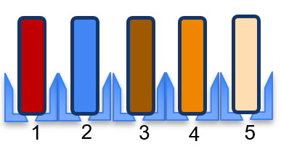
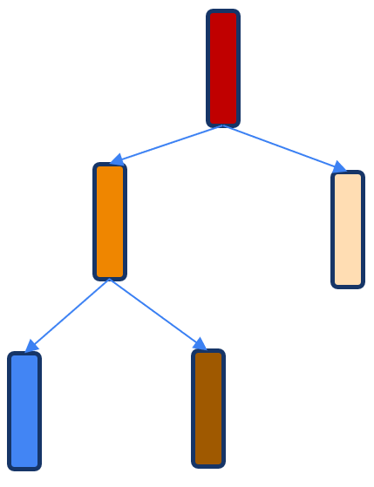
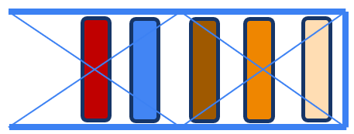
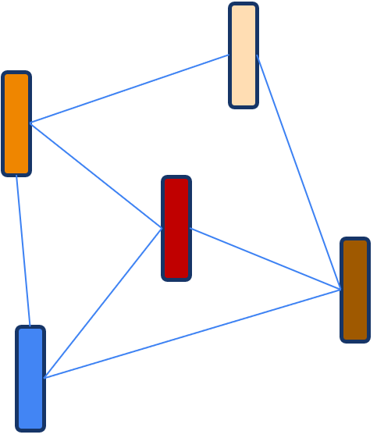
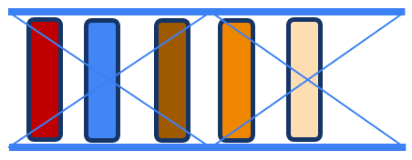
Notes:
Given a collection of data
We can arrange them in various ways
Random access, Last in First out, First in first out, Hierarchical, network, etc.

Slide 27
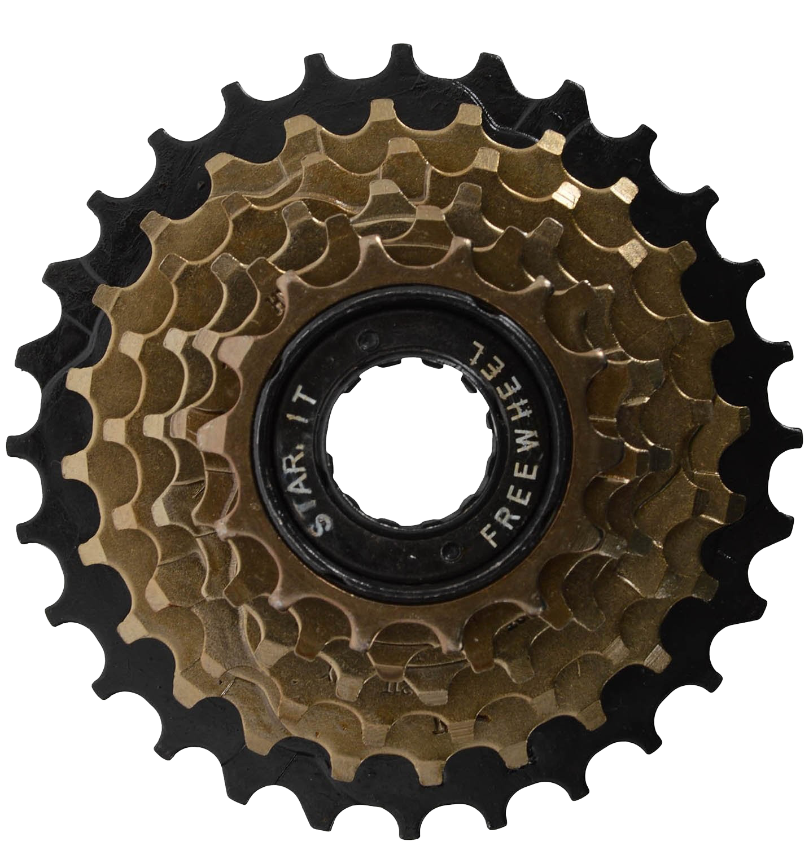
The Procedure is called ALGORITHM
Removal
Insertion
Notes:
For each of these structures, there are associated operations to insert data in an specific manner, or remove the data from the structure in a specific manner
<>
Each of this operation INSERTION or REMOVAL is a well defined task, and it is executed by following specific well defined steps of sub-operations.
These well defined unambiguous sequence of sub-operations to perform the target task is known as algorithm.

Slide 28
What is a data structure?
+
Operations
+
=
Data Structure
Organization
Algorithm
Notes:
Now what is data structure?
It is a way of organizing data
With associated set of operations which can be applied on them
Implemented with well defined algorithms.

Slide 30
What is a program?
How is it related to data structure?
How is it related to algorithm?
Notes:
Hello, Welcome back
In the previous lesson we have discussed what is a data structure and what is an algorithm with an example.
Today we will discuss what is a program, and how is it related to data structure and algorithm.
We will pickup two computing examples and try to understand the underlying concept.

Slide 31
First computing problem

Slide 32
Find factorial of an integer number
Estimate: $n!=n×\left(n−1\right)×\left(n−2\right)×… ×3×2×1$.
Now, the questions are -
What is the underlying data needed for this problem?
n
1
What is the size of its data (the number of data values)
Where to store the data?
RAM
Notes:
First question first
The underlying data for this problem is n
The size of the data is 1.
The data will be stored in the primary memory of the computer i.e, RAM

Slide 33
Find factorial of an integer number
Algorithm: $n!=n×\left(n−1\right)×\left(n−2\right)×… ×3×2×1$.
6
RAM
Notes:
Let us say, the value of n is 6. and it is stored at an arbitrary memory location in RAM as shown in figure.
The size of the data is 1
Now the question is, do we need a data structure?
As it has only one data value, no structure is associated with the data.

Slide 34
Find factorial of an integer number
Algorithm: $n!=n×\left(n−1\right)×\left(n−2\right)×… ×3×2×1$.
6
RAM
Notes:
This is like a point in space.
A point has no structure
When you have multiple points, a structure started developing like
Linear arrangement

Slide 35
Find factorial of an integer number
Algorithm: $n!=n×\left(n−1\right)×\left(n−2\right)×… ×3×2×1$.
Primitive data structure
6
RAM
Notes:
OR, non linear arrangement
If the data has only one value needing only one variable with a defined data type, then it is known as primitive data structure

Slide 36
Find factorial of an integer number
Algorithm: $n!=n×\left(n−1\right)×\left(n−2\right)×… ×3×2×1$.
Primitive Data Structure
#include <stdio.h>
main(){
int n = 6, fac = 1;
while (n >= 1) {
fac = fac * n;
n = n-1;
}
printf("The factorial is %d", fac);
}
6
Algorithm
RAM
Notes:
Now, let us see the program to estimate factorial of n
I have considered C programming language for implementing the examples
I have a primitive data structure to organize the data, and
An algorithm to estimate the factorial.

Slide 37
Second computing problem
Notes:
Let us see the second problem

Slide 38
Given a collection of integer numbers, find a number in the collection
{ 3, 10, 4, 6, 7 }
10
Five different primitive data structures
#include <stdio.h>
main(){
int a = 3, b = 10, c = 4, d = 6, e = 7;
int ele = 4;
if (a == ele) printf(“found”);
else if (b == ele) printf(“found”);
else if (c == ele) printf(“found”);
else if (d == ele) printf(“found”);
else if (e == ele) printf(“found”);
else printf(“not found”);
}
3
4
6
7
RAM
Notes:
Let us say, the given collection has five data values - 3, 10, 4, 6, 7
Now, you have two choices – Either you use five different primitive data structures, which are defined at five arbitrary locations in memory
To store the five data values in the collection.
And, Compare each one of them for the number that you are looking at

Slide 39
Find a number in a given collection of integer numbers
{ 3, 10, 4, 6, 7 }
Five different primitive data structures
Use a data structure
Notes:
Now, the question is which data structure you are going to consider, this, or this or this
Depending on the type of data structure you choose, the algorithm to solve the problem will also be different

Slide 40
Given a collection of integer numbers, find a number in the collection
{ 3, 10, 4, 6, 7 }
3
10
4
6
7
RAM
Notes:
Now I have considered this data structure which is random access.
This can be realized in memory in this manner
All the elements are stored linearly in the consecutive memory locations in RAM

Slide 41
Find a number in a given collection of integer numbers
Data Structure
#include <stdio.h>
main(){
int find = 10, collection[]={3, 10, 4, 6, 7}, i;
/* check every element in the collection and check the occurrence of 10. */
for(i=0; i<5; i++) {
if(collection[i] == find)
break;
}
if(i<5)
printf("Found");
else printf("Not found");
}
3
10
4
6
7
RAM
Algorithm
Notes:
This a program to solve the problem

Slide 42
What is a program?
+
=
Program
Data Structure
Algorithm

Slide 43
Let us repeat again
Every Data Structure will have
A way to store the data in a specific manner in memory (RAM)
A set of operations that can be applied (INSERT, REMOVE, MODIFY,…)
Every operation will be defined by an ALGORITHM
So, a data structure is defined by data organization + set of operations + respective algorithms
An algorithm defines a finite unambiguous steps to solve a problem.
Solving a problem will need data structures to store the necessary data
So, data structure + algorithm define a computing program

Slide 44
In this course
You will learn different types of data structures
Different operations of each of the data structure
Algorithm and implementation of the operations
Applications of different types of data structure for solving real world problems.

Slide 46
Basic Terminologies

Slide 47
Data, Data Elements, Data type
Data: Collection of raw facts
Collection of integer number -{3, 7, 2, 5, 7}
Collection of cities - {“Delhi”, “Mumbai”, “Kolkata”, “Pune”}
Collection of Students’ record
{ {“John”, 25, “Assam”},
{“James”, 35,”Bengal”},
{“Kaur”, 28, Punjab}
}
Data element: It is a logical unit constituting a data.
Data type: It specifies the type of value or values of data elements constituting a data.
Name: An instance of a data structure should be assigned a name.

Slide 48
Storage Structure
All the data structures defined in a program are stored in Computer’s memory
Two types of memory
Primary memory (RAM)
Secondary memory (Hard disk)
All the instances of data structures used in a program are defined in RAM
Depending on the nature of memory allocation pattern, a data structure could follow
Contiguous Memory Allocation
Non-Contiguous Memory Allocation

Slide 49
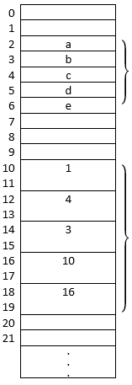
Contiguous Memory Allocation
The data elements of a data structure will be stored at contiguous memory locations in memory
DataStr1 = {‘a’, ‘b’, ‘c’, ‘d’, ‘e’} which holds five characters
DataStr2 = {1, 4, 3, 10, 16} which holds five integer numbers
Memory

Slide 50
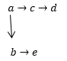
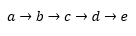
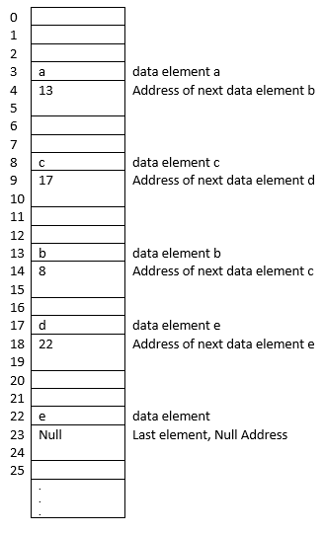
Non-Contiguous Memory Allocation
The data elements of a data structure will be stored at non-contiguous arbitrary locations in memory.
Linear

Slide 51
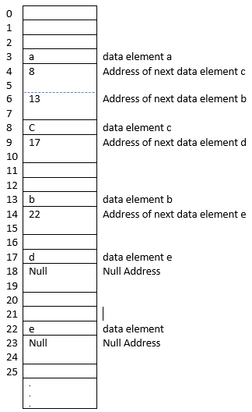
Non-Contiguous Memory Allocation
The data elements of a data structure will be stored at non-contiguous arbitrary locations in memory.
Nonlinear

Slide 52
Advantages of Contiguous Memory Allocation
Ordering - The data elements are ordered linearly, i.e., 1st, 2nd, 3rd, 4th and so on.
Random Access Memory - If the address of the first data element is known, the address of any data element can be directly derived by its index without scanning the other data elements.
No additional memory is needed, other than the memory required for storing the data elements.

Slide 53
Disadvantages of Contiguous Memory Allocation
Static Allocation - Once memory is allocated, it cannot be changed.
OS Defragmentation - If sufficient contiguous space for storing the data elements is not available, it may result in operating system defragmentation and additional system I/O operations.
Un-used Memory - The programmer may have reserved a large block of memory, but actually used only a small portion of the reserved memory, resulting in underutilization of the allotted storage.
Large RAM - Computer’s RAM should have enough contiguous block of memory to support the storage.

Slide 54
Advantages of Non-contiguous Memory Allocation
Dynamic Allocation - Data can grow in run time.
Availability of large contiguous block of memory for storing the data elements is not required.

Slide 55
Disadvantages of Non-contiguous
Additional memory is needed to store the addresses of other data elements.
It has higher storage requirement as compared to its contiguous counterpart.
Data Access - For accessing an element, one may need to traverse through the other data elements to get the address of the target element.

Slide 56
Operations on Data Structures
Creation: Create an empty instance of a data structure.
Insertion: Insert a data element into an instance of a data structure.
Deletion: Delete a data element from an instance of a data structure.
Updation: Change the value of a data element
Searching: Search for the existence or non-existence of a data element
Traversal: Visits every data element in an instance of a data structure.
Sorting: Order the data elements either in ascending or descending order.
Merging: Combines data elements of two or more data structures to one.

Slide 57
Properties of Algorithm
An algorithm is a well-defined list of finite unambiguous steps for solving a problem.
Input Specified: Input to an algorithm should be clearly specified. An algorithm can have zero or more inputs.
Output Specified: Output of an algorithm should be clearly specified. An algorithm has one or more outputs.
Definiteness: Every step of an algorithm should be unambiguous.
Finiteness: Every algorithm should terminate after a finite number of steps.
Effectiveness: The steps of an algorithm should be sufficiently basic and doable by a person in a finite time with pencil and paper.

Slide 58
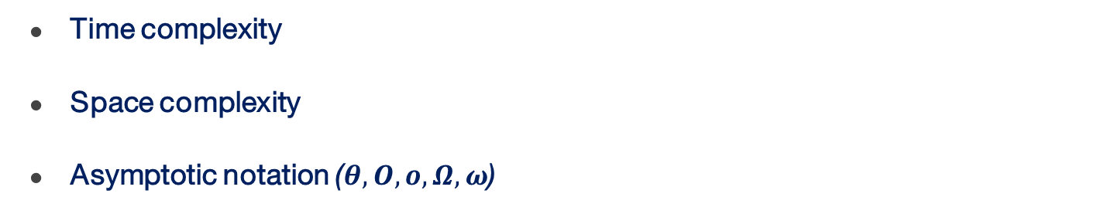
Complexity of Algorithm
Time complexity
Space complexity
Asymptotic notation ($θ,O,o,Ω,ω$)

Slide 59
Classification of Data Structure
Primitive vs Non-primitives
Linear vs Nonlinear
Homogeneous vs Heterogeneous
Static vs Dynamics

Slide 60
Non-primitives data structures
Array
Linked List
Stack and Queues
Tree/Binary tree
Hash
Graph

Slide 62
Array Data Structure

Slide 63
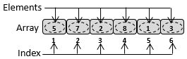
Definition
An array is a collection of finite number of homogeneous data elements stored at contiguous memory locations.
5
7
2
8
1
Homogeneous means, the data elements are of the same type.
3
It is a linear data structure, because its data elements are ordered as first, second, third, and so on.
RAM
The data elements of an array are stored at contiguous memory locations linearly.

Slide 64
Definition
An array is a collection of finite number of homogeneous data elements stored at contiguous memory locations.
5
7
2
8
1
3
The elements of the array are access using INDEX.
INDEX defines the location and ordering of the data elements.
RAM

Slide 65
Definition
An array is a collection of finite number of homogeneous data elements stored at contiguous memory locations.
5
7
2
8
1
3
LOWER BOUND defines the location of the first element
UPPER BOUND defines the location of the last element
RAM
SIZE = UPPER BOUND – LOWER BOUND +1

Slide 66
Definition
An array is a collection of finite number of homogeneous data elements stored at contiguous memory locations.
5
7
2
8
1
3
If the name of the array is A, and lower bound starts from 1
A[1] represents the first element
RAM
A[2] represents the second element
A[3] represents the third element

Slide 67
Definition
An array is a collection of finite number of homogeneous data elements stored at contiguous memory locations.
5
7
2
8
1
3
If the name of the array is A, and lower bound starts from 1
A[1] represents the first element
RAM
A[2] represents the second element
A[3] represents the third element

Slide 68
Definition
An array is a collection of finite number of homogeneous data elements stored at contiguous memory locations.
5
7
2
8
1
3
Any element of the array A can be randomly accessed using A[i]
RAM

Slide 69
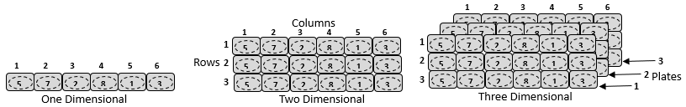
Types of Array
1(one) Dimensional
Multi-Dimensional
1(one)-Dimensional array is an array of zero dimensional arrays
2(two)-Dimensional array is an array of one dimensional arrays
3(three)-Dimensional array is an array of two dimensional arrays
n-Dimensional array is an array of (n-1) dimensional arrays

Slide 70
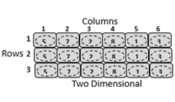
2 Dimensional Array
Number of Rows defines the number of 1D arrays
Number of Columns defines the number of elements in each 1D arrays
The size of constituent 1D arrays are same.
An element of a 2D array is accessed using Row index and Column index
Size = |Columns| x |Rows|

Slide 71
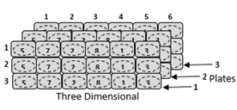
3 Dimensional Array
In addition to Rows and Columns, it also has Plates
The size of constituent 2D arrays are same.
An element of a 3D array is accessed using Row index, Column index and Plate index
Size = |Plates| x |Columns| x |Rows|

Slide 72
n-Dimensional Array
n-Dimensional array is an array of (n-1) dimensional array
The size of constituent (n-1) Dimensional arrays are same.
An element of a 3D array is accessed using n-index, (n-1)-index, (n-2)-index
(n-3)-index, and so on upto 1st-index.
Example: A[3][2][4]….[1][3]

Slide 74
Representation of Arrays in Memory

Slide 75
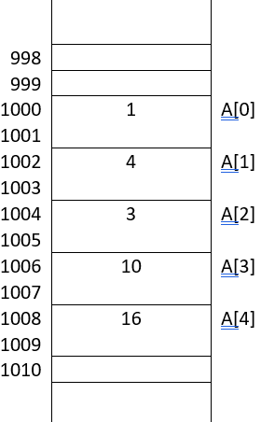
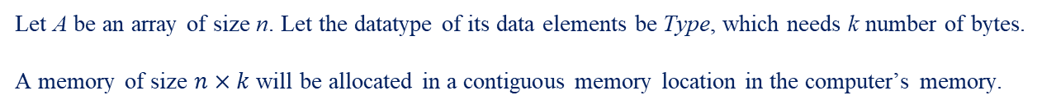
1D Arrays
Let A be an array of size n. Let the datatype of its data elements be Type, which needs k number of bytes.
A memory of size $n×k$ will be allocated in a contiguous memory location in the computer’s memory.
The address of the first element is known as BASE address.
In this example,
k = 2
n = 5
Total memory allocated is 5 x 2 = 10 bytes

Slide 76
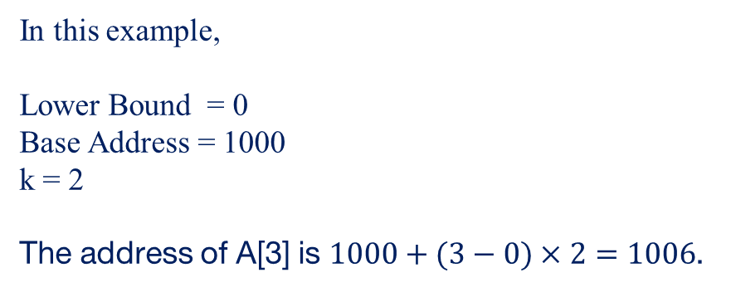
1D Arrays
$Effective Address of A\left[i\right]=base address+(i−LB)×k$
In this example,
Lower Bound = 0
Base Address = 1000
k = 2
The address of A[3] is $1000+(3−0)×2=1006$.

Slide 77
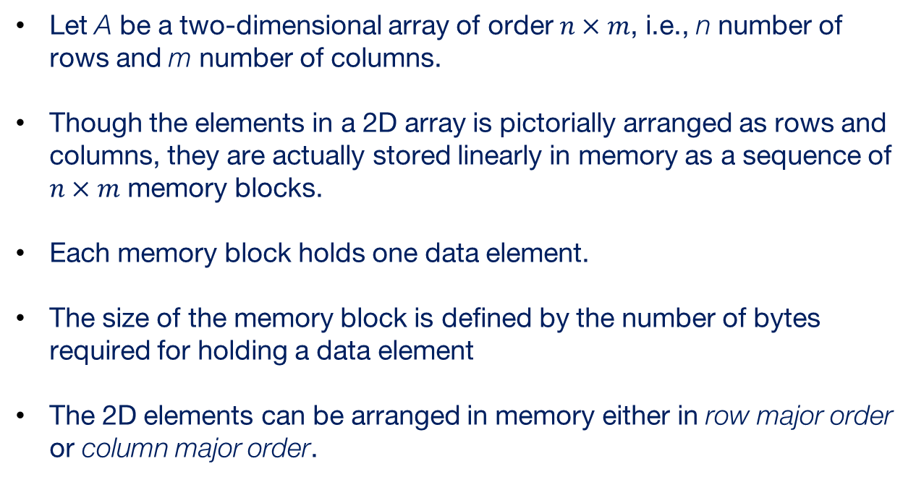
2D Arrays
Let A be a two-dimensional array of order $n×m$, i.e., n number of rows and m number of columns.
Though the elements in a 2D array is pictorially arranged as rows and columns, they are actually stored linearly in memory as a sequence of $n×m$ memory blocks.
Each memory block holds one data element.
The size of the memory block is defined by the number of bytes required for holding a data element
The 2D elements can be arranged in memory either in row major order or column major order.

Slide 78
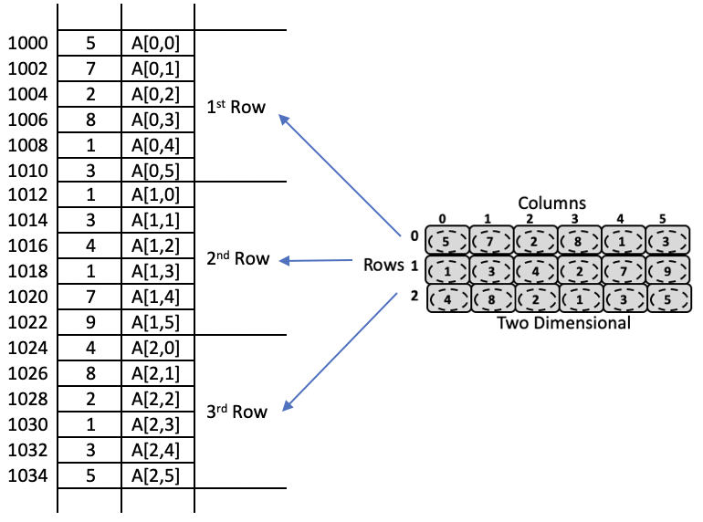
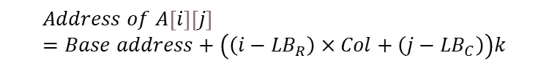
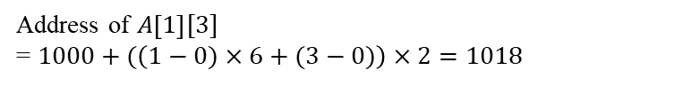
2D Arrays
In row major order, the elements are stored row-wise i.e., the elements in the first row, then the elements in the second row, and so on.
$$Address of A\left[i\right]\left[j\right]=Base address+\left(\left(i−{LB}_{R}\right)×Col+\left(j−{LB}_{C}\right)\right)k$$
Address of $A\left[1\right][3]$
= $1000+(\left(1−0)×6+(3−0)\right)×2=1018$

Slide 79
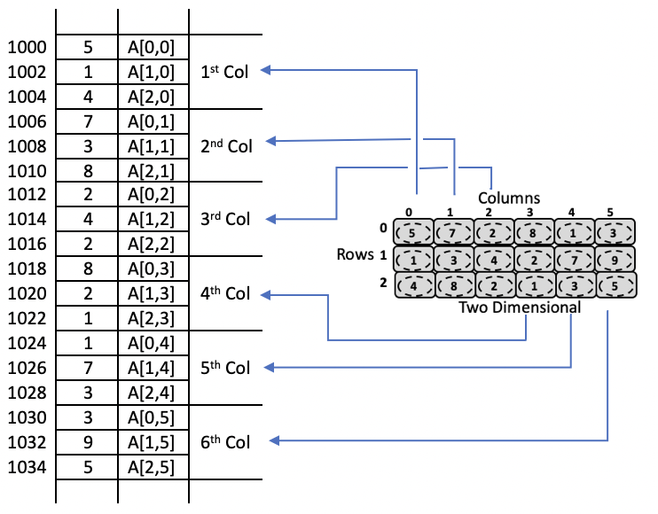
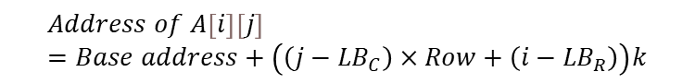
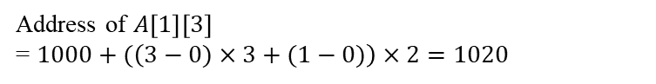
2D Arrays
In column major order, the elements are stored column-wise i.e., the elements in the first column, then the elements in the second column, and so on.
$$Address of A\left[i\right]\left[j\right]=Base address+\left(\left(j−{LB}_{C}\right)×Row+\left(i−{LB}_{R}\right)\right)k$$
Address of $A\left[1\right]\left[3\right]$
= $1000+(\left(3−0)×3+(1−0)\right)×2=1020$

Slide 80
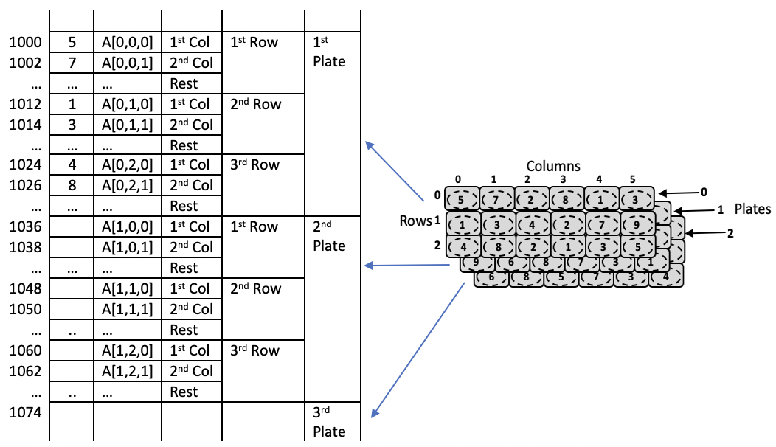
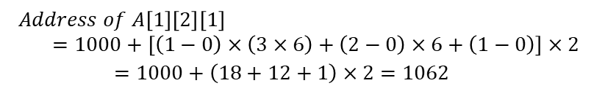
3D Arrays
$$Address of A\left[1\right]\left[2\right]\left[1\right]=1000+\left[\left(1−0\right)×\left(3×6\right)+\left(2−0\right)×6+\left(1−0\right)\right]×2$$
$$=1000+\left(18+12+1\right)×2=1062$$

Slide 81
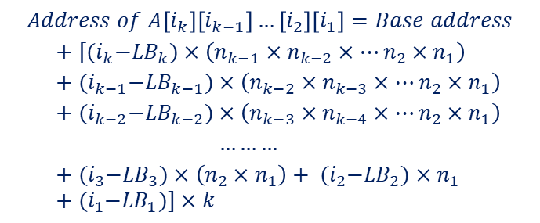
n-D Arrays
$$Address of A\left[i_{k}\right]\left[i_{k−1}\right]…\left[i_{2}\right]\left[i_{1}\right]=Base address$$
$$+ [{(i}_{k}−{LB}_{k})×\left(n_{k−1}×n_{k−2}×…{n_{2}×n}_{1}\right)$$
$$+ {(i}_{k−1}−{LB}_{k−1})×\left(n_{k−2}×n_{k−3}×…{n_{2}×n}_{1}\right)$$
$$+ {(i}_{k−2}−{LB}_{k−2})×\left(n_{k−3}×n_{k−4}×…{n_{2}×n}_{1}\right)$$
$$………$$
$$+ {(i}_{3}−{LB}_{3})×\left({n_{2}×n}_{1}\right)+ {(i}_{2}−{LB}_{2})×n_{1}+{(i}_{1}−{LB}_{1})]×k$$

Slide 83
Operations on Array Data Structure
Notes:
In this discussion, We will consider one dimensional array.

Slide 84
Operations on Array Data Structure
00
Create
01
Display/Traverse
02
Search
03
Insertion
04
Deletion
05
Modification/Update

Slide 85
Create Operation

Slide 86
Create Operation
It creates an empty Array. It just allocates the required memory in RAM

Slide 87
Create Operation
It creates an empty Array. It just allocates the required memory in RAM
In C programming Language, an array can be created in two ways:
Compile Time: Static memory allocation
Notes:
I have considered C programming language for the examples in this course. Arrays can be created either using static memory allocation or dynamic memory allocation

Slide 88
Create Operation
It creates an empty Array. It just allocates the required memory in RAM
In C programming Language, an array can be created in two ways:
Compile Time: Static memory allocation
Run Time: Dynamic memory allocation
Notes:
I have considered C programming language for the examples in this course. Arrays can be created either using static memory allocation or dynamic memory allocation

Slide 89
Compile time
The memory is reserved at compile time.
Examples:
A one dimensional integer array of size 100:
int A[100];
Notes:
I have considered C programming language for the examples in this course. Arrays can be created either using static memory allocation or dynamic memory allocation

Slide 90
Compile time
The memory is reserved at compile time.
Examples:
A one dimensional character array of size 100:
char A[100];
Notes:
I have considered C programming language for the examples in this course. Arrays can be created either using static memory allocation or dynamic memory allocation

Slide 91
Compile time
The memory is reserved at compile time.
Examples:
A two dimensional integer array of size 20x30:
int A[20][30];
Notes:
I have considered C programming language for the examples in this course. Arrays can be created either using static memory allocation or dynamic memory allocation

Slide 92
Compile time
The memory is reserved at compile time.
Examples:
A three dimensional integer array of size 10x20x30:
int A[10][20][30];
Notes:
I have considered C programming language for the examples in this course. Arrays can be created either using static memory allocation or dynamic memory allocation

Slide 93
Compile time
The memory is reserved at compile time.
Examples:
A three dimensional integer array of size 10x20x30:
int A[10][20][30];
Syntax:
<data type> <Name>[size] [size][size]…[size]
Notes:
I have considered C programming language for the examples in this course. Arrays can be created either using static memory allocation or dynamic memory allocation

Slide 94
Run time
It can be created using a function called malloc.
malloc() allocates a memory block of given size (in bytes) and returns address of the beginning of the block.
Syntax: <data type> *<Name>;
<data type> *<Name> = (<data type> *) malloc (size in byte);
Example:
int *A;
int *A = (int*) malloc (sizeof(int)*100);
Notes:
I have considered C programming language for the examples in this course. Arrays can be created either using static memory allocation or dynamic memory allocation

Slide 95
Run time – 2 Dimensional
Example: int* A[5];
for (i = 0; i < 5; i++)
A[i] = (int*) malloc (10 * sizeof(int));
Notes:
I have considered C programming language for the examples in this course. Arrays can be created either using static memory allocation or dynamic memory allocation

Slide 96
Display/Traversal Operation

Slide 97
Display/Traversal Operation
Task: Visit all the elements in the array

Slide 98
Display/Traversal Operation
Task: Visit all the elements in the array
3 | 5 | 6 | 10 | 13 | 17 | 19 | 20
0 | 1 | 2 | 3 | 4 | 5 | 6 | 7

Slide 99
Display/Traversal Operation
Task: Visit all the elements in the array
3 | 5 | 6 | 10 | 13 | 17 | 19 | 20
0 | 1 | 2 | 3 | 4 | 5 | 6 | 7
Function:
Display(int A[], int n){
int i;
/*Visit every element */
for(i=0; i<n; i++) {
printf(”%d”, A[i]);
}
}

Slide 100
Display/Traversal Operation
Task: Visit all the elements in the array
3 | 5 | 6 | 10 | 13 | 17 | 19 | 20
0 | 1 | 2 | 3 | 4 | 5 | 6 | 7
Function:
Display(int A[], int n){
int i;
/*Visit every element */
for(i=0; i<n; i++) {
printf(”%d”, A[i]);
}
}
Time Complexity: defined by the number of elements visited i.e., $θ(n)$
Space Complexity: defined by the space required for storing elements i.e., $θ(n)$

Slide 101
Search Operation

Slide 102
Search Operation
Task: Given an element, check if it is present in the array

Slide 103
Search Operation
Task: Given an element, check if it is present in the array
3 | 5 | 6 | 10 | 13 | 17 | 19 | 20
0 | 1 | 2 | 3 | 4 | 5 | 6 | 7
10

Slide 104
Search Operation
Task: Given an element, check if it is present in the array
Algorithm: Scan the array from first index and check for the element
3 | 5 | 6 | 10 | 13 | 17 | 19 | 20
0 | 1 | 2 | 3 | 4 | 5 | 6 | 7
10

Slide 105
Search Operation
Task: Given an element, check if it is present in the array
Algorithm: Scan the array from first index and check for the element
3 | 5 | 6 | 10 | 13 | 17 | 19 | 20
0 | 1 | 2 | 3 | 4 | 5 | 6 | 7
10
NO

Slide 106
Search Operation
Task: Given an element, check if it is present in the array
Algorithm: Scan the array from first index and check for the element
3 | 5 | 6 | 10 | 13 | 17 | 19 | 20
0 | 1 | 2 | 3 | 4 | 5 | 6 | 7
10
NO

Slide 107
Search Operation
Task: Given an element, check if it is present in the array
Algorithm: Scan the array from first index and check for the element
3 | 5 | 6 | 10 | 13 | 17 | 19 | 20
0 | 1 | 2 | 3 | 4 | 5 | 6 | 7
10
NO

Slide 108
Search Operation
Task: Given an element, check if it is present in the array
Algorithm: Scan the array from first index and check for the element
3 | 5 | 6 | 10 | 13 | 17 | 19 | 20
0 | 1 | 2 | 3 | 4 | 5 | 6 | 7
10
YES

Slide 109
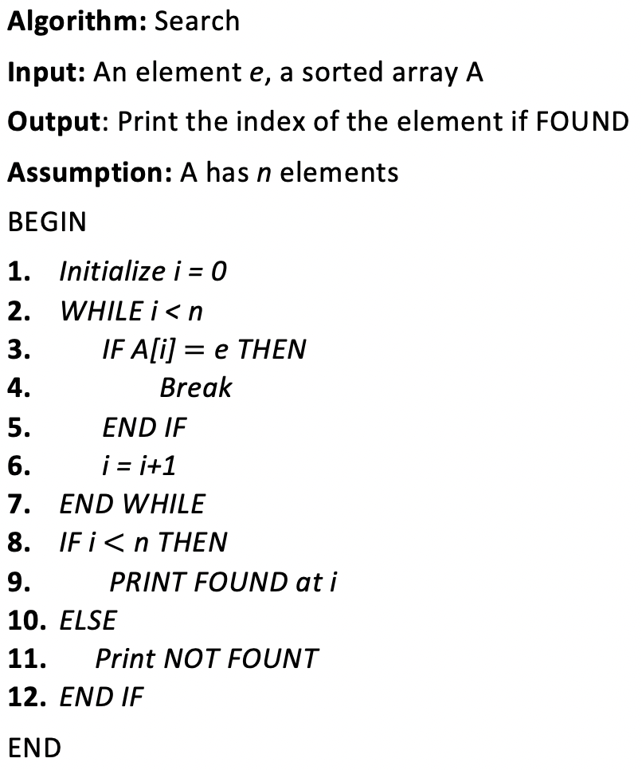
Search Operation
Algorithm: Check every element in the array
3 | 5 | 6 | 10 | 13 | 17 | 19 | 20
0 | 1 | 2 | 3 | 4 | 5 | 6 | 7
10

Slide 110
Search Operation
Algorithm: Check every element in the array
3 | 5 | 6 | 10 | 13 | 17 | 19 | 20
0 | 1 | 2 | 3 | 4 | 5 | 6 | 7
Function:
Search(int A[], int ele, int n){
int i;
/* check every element in the collection */
for(i=0; i<n; i++) {
if(A[i] == ele) return i;
}
return -1;
}

Slide 111
Search Operation
Algorithm: Check every element in the array
3 | 5 | 6 | 10 | 13 | 17 | 19 | 20
0 | 1 | 2 | 3 | 4 | 5 | 6 | 7
Time Complexity:
There are three possible cases:
Best Case
Worst Case
Average case

Slide 112
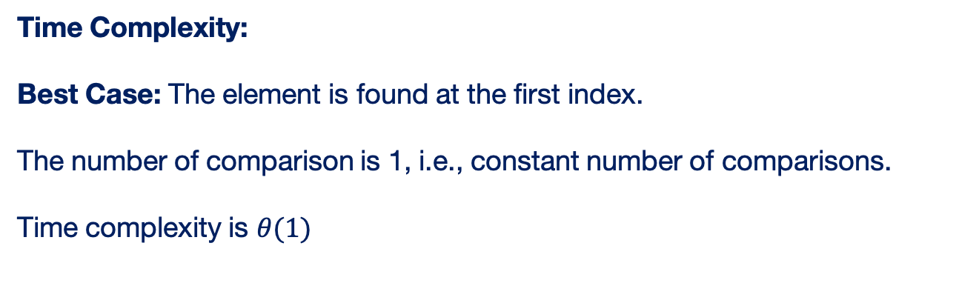
Search Operation
Algorithm: Check every element in the array
3 | 5 | 6 | 10 | 13 | 17 | 19 | 20
0 | 1 | 2 | 3 | 4 | 5 | 6 | 7
Time Complexity:
Best Case: The element is found at the first index.
The number of comparison is 1, i.e., constant number of comparisons.
Time complexity is $θ(1)$

Slide 113
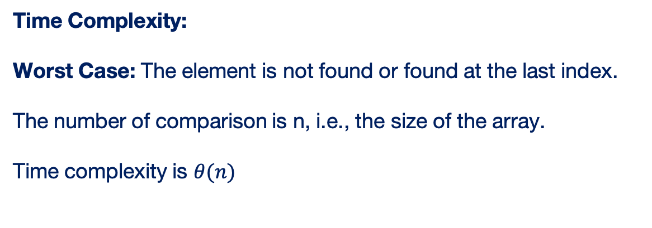
Search Operation
Algorithm: Check every element in the array
3 | 5 | 6 | 10 | 13 | 17 | 19 | 20
0 | 1 | 2 | 3 | 4 | 5 | 6 | 7
Time Complexity:
Worst Case: The element is not found or found at the last index.
The number of comparison is n, i.e., the size of the array.
Time complexity is $θ(n)$

Slide 114
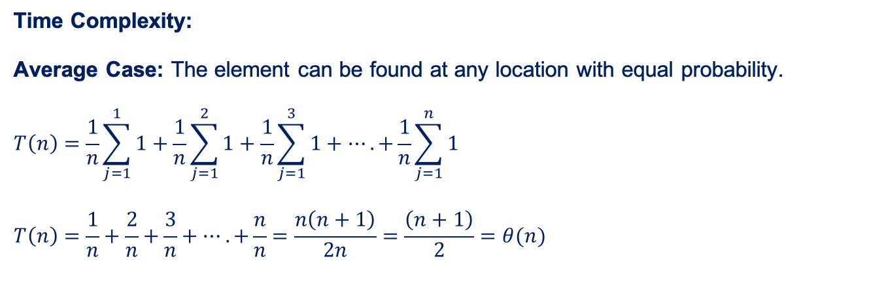
Search Operation
Algorithm: Check every element in the array
3 | 5 | 6 | 10 | 13 | 17 | 19 | 20
0 | 1 | 2 | 3 | 4 | 5 | 6 | 7
Time Complexity:
Average Case: The element can be found at any location with equal probability.
$$T\left(n\right)=\frac{1}{n}\sum_{j=1}^{1}{1}+\frac{1}{n}\sum_{j=1}^{2}{1}+\frac{1}{n}\sum_{j=1}^{3}{1}+….+\frac{1}{n}\sum_{j=1}^{n}{1}$$
$$T\left(n\right)=\frac{1}{n}+\frac{2}{n}+\frac{3}{n}+….+\frac{n}{n}=\frac{n\left(n+1\right)}{2n}=\frac{\left(n+1\right)}{2}=θ(n)$$

Slide 115

Search Operation
Algorithm: Check every element in the array
3 | 5 | 6 | 10 | 13 | 17 | 19 | 20
0 | 1 | 2 | 3 | 4 | 5 | 6 | 7
Space Complexity: $size of the array i.e., θ(n)$

Slide 116
Insertion Operation

Slide 117
Insertion Operation
Task: Insert an element at an arbitrary index $i≥0.$
3 | 5 | 6 | 10 | 13 | 17 | 19 | 20
0 | 1 | 2 | 3 | 4 | 5 | 6 | 7 | 8 | 9

Slide 118
Insertion Operation
Task: Insert an element at an arbitrary index $i≥0.$
3 | 5 | 6 | 10 | 13 | 17 | 19 | 20
0 | 1 | 2 | 3 | 4 | 5 | 6 | 7 | 8 | 9
Assumptions:
1. The array has reserved enough memory to accommodate the new element.
2. If there are n elements, the first n locations are occupied.
3. After inserting new element, the first n+1 elements will be occupied.

Slide 119
Insertion Operation
3 | 5 | 6 | 10 | 13 | 17 | 19 | 20
0 | 1 | 2 | 3 | 4 | 5 | 6 | 7 | 8 | 9
Task: Insert an element at an arbitrary index $i≥0.$
3 | 5 | 6 | 10 | 13 | 17 | 19 | 20
0 | 1 | 2 | 3 | 4 | 5 | 6 | 7 | 8 | 9

Slide 120
Insertion Operation
3 | 5 | 6 | 10 | 13 | 17 | 19 | 20
0 | 1 | 2 | 3 | 4 | 5 | 6 | 7 | 8 | 9
Task: Insert an element at an arbitrary index $i≥0.$
3 | 5 | 6 | 10 | 13 | 17 | 19 | 20
0 | 1 | 2 | 3 | 4 | 5 | 6 | 7 | 8 | 9
Step - 1: Free the index $i$ for the new element

Slide 121
Insertion Operation
3 | 5 | 6 | 10 | 13 | 17 | 19 | 20
0 | 1 | 2 | 3 | 4 | 5 | 6 | 7 | 8 | 9
Task: Insert an element at an arbitrary index $i≥0.$
3 | 5 | 6 | 10 | 13 | 17 | 19 | 20
0 | 1 | 2 | 3 | 4 | 5 | 6 | 7 | 8 | 9
Step - 1: Free the index $i$ for the new element
3 | 5 | 6 | 10 | 13 | 17 | 19 |  | 20
0 | 1 | 2 | 3 | 4 | 5 | 6 | 7 | 8 | 9
A[n] = A[n-1] i.e., A[8] = A[7]

Slide 122
Insertion Operation
3 | 5 | 6 | 10 | 13 | 17 | 19 | 20
0 | 1 | 2 | 3 | 4 | 5 | 6 | 7 | 8 | 9
Task: Insert an element at an arbitrary index $i≥0.$
3 | 5 | 6 | 10 | 13 | 17 | 19 | 20
0 | 1 | 2 | 3 | 4 | 5 | 6 | 7 | 8 | 9
Step - 1: Free the index $i$ for the new element
3 | 5 | 6 | 10 | 13 | 17 |  | 19 | 20
0 | 1 | 2 | 3 | 4 | 5 | 6 | 7 | 8 | 9
A[7] = A[6]

Slide 123
Insertion Operation
3 | 5 | 6 | 10 | 13 | 17 | 19 | 20
0 | 1 | 2 | 3 | 4 | 5 | 6 | 7 | 8 | 9
Task: Insert an element at an arbitrary index $i≥0.$
3 | 5 | 6 | 10 | 13 | 17 | 19 | 20
0 | 1 | 2 | 3 | 4 | 5 | 6 | 7 | 8 | 9
Step - 1: Free the index $i$ for the new element
3 | 5 | 6 | 10 | 13 |  | 17 | 19 | 20
0 | 1 | 2 | 3 | 4 | 5 | 6 | 7 | 8 | 9
A[6] = A[5]

Slide 124
Insertion Operation
3 | 5 | 6 | 10 | 13 | 17 | 19 | 20
0 | 1 | 2 | 3 | 4 | 5 | 6 | 7 | 8 | 9
Task: Insert an element at an arbitrary index $i≥0.$
3 | 5 | 6 | 10 | 13 | 17 | 19 | 20
0 | 1 | 2 | 3 | 4 | 5 | 6 | 7 | 8 | 9
Step - 1: Free the index $i$ for the new element
3 | 5 | 6 | 10 |  | 13 | 17 | 19 | 20
0 | 1 | 2 | 3 | 4 | 5 | 6 | 7 | 8 | 9
A[5] = A[4]

Slide 125
Insertion Operation
3 | 5 | 6 | 10 | 13 | 17 | 19 | 20
0 | 1 | 2 | 3 | 4 | 5 | 6 | 7 | 8 | 9
Task: Insert an element at an arbitrary index $i≥0.$
3 | 5 | 6 | 10 | 13 | 17 | 19 | 20
0 | 1 | 2 | 3 | 4 | 5 | 6 | 7 | 8 | 9
Step - 1: Free the index $i$ for the new element
3 | 5 | 6 |  | 10 | 13 | 17 | 19 | 20
0 | 1 | 2 | 3 | 4 | 5 | 6 | 7 | 8 | 9
A[4] = A[3]

Slide 126
Insertion Operation
3 | 5 | 6 | 10 | 13 | 17 | 19 | 20
0 | 1 | 2 | 3 | 4 | 5 | 6 | 7 | 8 | 9
Algorithm:
Repeat for j=UB+1 to i
A[j]=A[j-1]
End Repeat
Task: Insert an element at an arbitrary index $i≥0.$
3 | 5 | 6 | 10 | 13 | 17 | 19 | 20
0 | 1 | 2 | 3 | 4 | 5 | 6 | 7 | 8 | 9
Step - 1: Free the index $i$ for the new element
Program Segment:
for(j=n; j>i; j--)
A[j] = A[j-1]
3 | 5 | 6 |  | 10 | 13 | 17 | 19 | 20
0 | 1 | 2 | 3 | 4 | 5 | 6 | 7 | 8 | 9

Slide 127
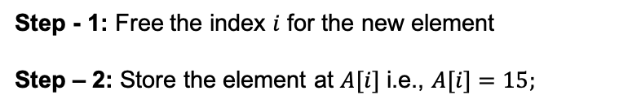
Insertion Operation
Algorithm:
Repeat for j=UB+1 to i
A[j]=A[j-1]
End Repeat
A[i] = ele
3 | 5 | 6 | 10 | 13 | 17 | 19 | 20
0 | 1 | 2 | 3 | 4 | 5 | 6 | 7 | 8 | 9
Task: Insert an element at an arbitrary index $i≥0.$
3 | 5 | 6 | 10 | 13 | 17 | 19 | 20
0 | 1 | 2 | 3 | 4 | 5 | 6 | 7 | 8 | 9
insert(int *A,int ele,int i,int *n){
int j;
for(j=*n; j>i; j--)
A[j] = A[j-1];
A[i] = ele;
}
Step - 1: Free the index $i$ for the new element
Step – 2: Store the element at $A[i]$ i.e., $A[i]=15;$
3 | 5 | 6 | 15 | 10 | 13 | 17 | 19 | 20
0 | 1 | 2 | 3 | 4 | 5 | 6 | 7 | 8 | 9

Slide 128
Insertion Operation
Algorithm:
Repeat for j=UB+1 to i
A[j]=A[j-1]
End Repeat
A[i] = ele
UB=UB+1
3 | 5 | 6 | 10 | 13 | 17 | 19 | 20
0 | 1 | 2 | 3 | 4 | 5 | 6 | 7 | 8 | 9
Task: Insert an element at an arbitrary index $i≥0.$
3 | 5 | 6 | 10 | 13 | 17 | 19 | 20
0 | 1 | 2 | 3 | 4 | 5 | 6 | 7 | 8 | 9
insert(int *A,int ele,int i,int *n){
int j;
for(j=*n; j>i; j--)
A[j] = A[j-1];
A[i] = ele;
*n = *n+1;
}
Step - 1: Free the index $i$ for the new element
Step – 2: Store the element at $A[i]$ i.e., $A[i]=15;$
3 | 5 | 6 | 15 | 10 | 13 | 17 | 19 | 20
0 | 1 | 2 | 3 | 4 | 5 | 6 | 7 | 8 | 9
Step – 3: Update the number of elements i.e., $UB=UB+1;$

Slide 129
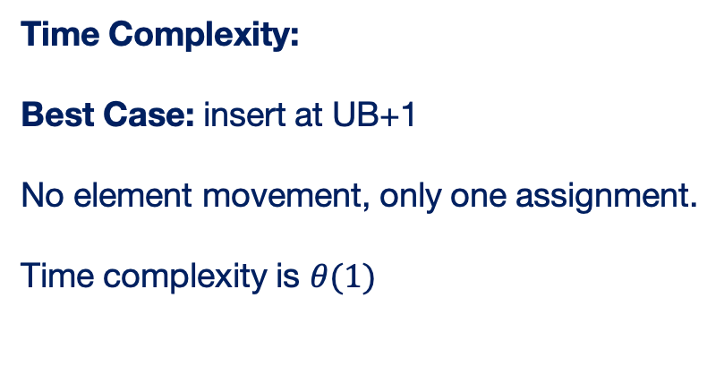
Insertion Operation
Algorithm:
Repeat for j=UB+1 to i
A[j]=A[j-1]
End Repeat
A[i] = ele
UB=UB+1
3 | 5 | 6 | 10 | 13 | 17 | 19 | 20
0 | 1 | 2 | 3 | 4 | 5 | 6 | 7 | 8 | 9
Time Complexity:
Best Case: insert at UB+1
No element movement, only one assignment.
Time complexity is $θ(1)$

Slide 130
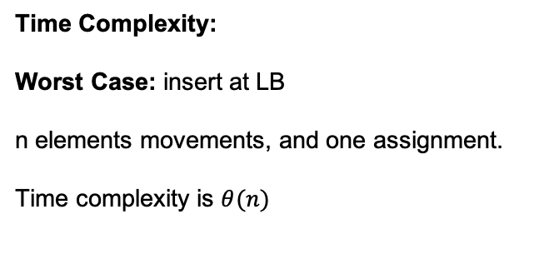
Insertion Operation
Algorithm:
Repeat for j=UB+1 to i
A[j]=A[j-1]
End Repeat
A[i] = ele
UB=UB+1
3 | 5 | 6 | 10 | 13 | 17 | 19 | 20
0 | 1 | 2 | 3 | 4 | 5 | 6 | 7 | 8 | 9
Time Complexity:
Worst Case: insert at LB
n elements movements, and one assignment.
Time complexity is $θ(n)$

Slide 131
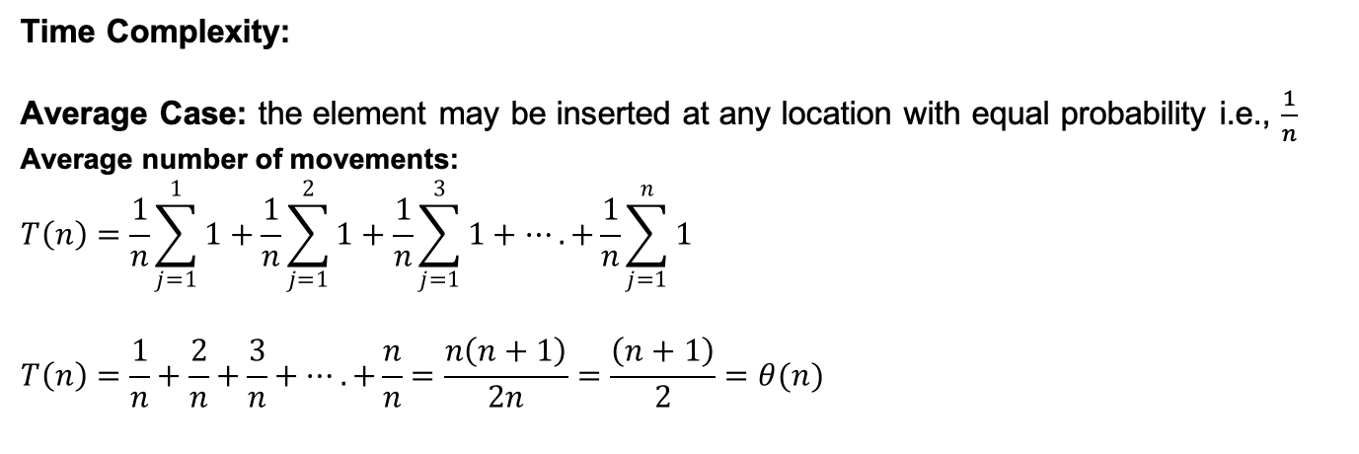
Insertion Operation
Algorithm:
Repeat for j=UB+1 to i
A[j]=A[j-1]
End Repeat
A[i] = ele
UB=UB+1
3 | 5 | 6 | 10 | 13 | 17 | 19 | 20
0 | 1 | 2 | 3 | 4 | 5 | 6 | 7 | 8 | 9
Time Complexity:
Average Case: the element may be inserted at any location with equal probability i.e., $\frac{1}{n}$
Average number of movements:
$$T\left(n\right)=\frac{1}{n}\sum_{j=1}^{1}{1}+\frac{1}{n}\sum_{j=1}^{2}{1}+\frac{1}{n}\sum_{j=1}^{3}{1}+….+\frac{1}{n}\sum_{j=1}^{n}{1}$$
$$T\left(n\right)=\frac{1}{n}+\frac{2}{n}+\frac{3}{n}+….+\frac{n}{n}=\frac{n\left(n+1\right)}{2n}=\frac{\left(n+1\right)}{2}=θ(n)$$

Slide 132
Deletion Operation on Array

Slide 133
Deletion Operation on Array
3 | 5 | 6 | 10 | 13 | 17 | 19 | 20
0 | 1 | 2 | 3 | 4 | 5 | 6 | 7 | 8 | 9
Task: Delete an element from an arbitrary index $i≥0.$
3 | 5 | 6 | 10 | 13 | 17 | 19 | 20
0 | 1 | 2 | 3 | 4 | 5 | 6 | 7 | 8 | 9

Slide 134
Deletion Operation on Array
3 | 5 | 6 | 10 | 13 | 17 | 19 | 20
0 | 1 | 2 | 3 | 4 | 5 | 6 | 7 | 8 | 9
Task: Delete an element from an arbitrary index $i≥0.$
3 | 5 | 6 | 10 | 13 | 17 | 19 | 20
0 | 1 | 2 | 3 | 4 | 5 | 6 | 7 | 8 | 9
Step - 1: Move all the succeeding elements of $i$ by one position forward
3 | 5 | 6 | 13 |  | 17 | 19 | 20
0 | 1 | 2 | 3 | 4 | 5 | 6 | 7 | 8 | 9

Slide 135
Deletion Operation on Array
3 | 5 | 6 | 10 | 13 | 17 | 19 | 20
0 | 1 | 2 | 3 | 4 | 5 | 6 | 7 | 8 | 9
Task: Delete an element from an arbitrary index $i≥0.$
3 | 5 | 6 | 10 | 13 | 17 | 19 | 20
0 | 1 | 2 | 3 | 4 | 5 | 6 | 7 | 8 | 9
Step - 1: Move all the succeeding elements of $i$ by one position forward
3 | 5 | 6 | 13 | 17 |  | 19 | 20
0 | 1 | 2 | 3 | 4 | 5 | 6 | 7 | 8 | 9

Slide 136
Deletion Operation on Array
3 | 5 | 6 | 10 | 13 | 17 | 19 | 20
0 | 1 | 2 | 3 | 4 | 5 | 6 | 7 | 8 | 9
Task: Delete an element from an arbitrary index $i≥0.$
3 | 5 | 6 | 10 | 13 | 17 | 19 | 20
0 | 1 | 2 | 3 | 4 | 5 | 6 | 7 | 8 | 9
Step - 1: Move all the succeeding elements of $i$ by one position forward
3 | 5 | 6 | 13 | 17 | 19 |  | 20
0 | 1 | 2 | 3 | 4 | 5 | 6 | 7 | 8 | 9

Slide 137
Deletion Operation on Array
3 | 5 | 6 | 10 | 13 | 17 | 19 | 20
0 | 1 | 2 | 3 | 4 | 5 | 6 | 7 | 8 | 9
Task: Delete an element from an arbitrary index $i≥0.$
3 | 5 | 6 | 10 | 13 | 17 | 19 | 20
0 | 1 | 2 | 3 | 4 | 5 | 6 | 7 | 8 | 9
Step - 1: Move all the succeeding elements of $i$ by one position forward
3 | 5 | 6 | 13 | 17 | 19 | 20
0 | 1 | 2 | 3 | 4 | 5 | 6 | 7 | 8 | 9

Slide 138
Deletion Operation on Array
Algorithm:
Repeat for j=i to UB-1
A[j]=A[j-1]
End Repeat
UB=UB-1
3 | 5 | 6 | 10 | 13 | 17 | 19 | 20
0 | 1 | 2 | 3 | 4 | 5 | 6 | 7 | 8 | 9
Task: Delete an element from an arbitrary index $i≥0.$
3 | 5 | 6 | 10 | 13 | 17 | 19 | 20
0 | 1 | 2 | 3 | 4 | 5 | 6 | 7 | 8 | 9
Step - 1: Move all the succeeding elements of $i$ by one position forward
delete(int *A, int i, int *n){
int j;
for(j=i; j<*n-1; j++)
A[j] = A[j+1];
*n = *n-1;
}
3 | 5 | 6 | 13 | 17 | 19 | 20
0 | 1 | 2 | 3 | 4 | 5 | 6 | 7 | 8 | 9
Step - 2: Reduce UB by 1 i.e., $UB=UB−1$

Slide 139
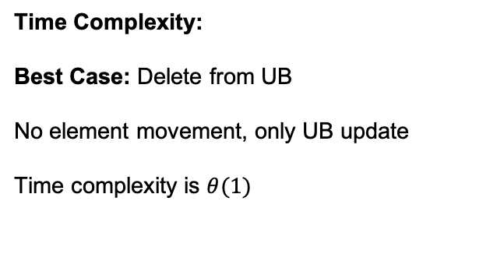
Delete Operation on Array
Algorithm:
Repeat for j=i to UB-1
A[j]=A[j-1]
End Repeat
UB=UB-1
3 | 5 | 6 | 10 | 13 | 17 | 19 | 20
0 | 1 | 2 | 3 | 4 | 5 | 6 | 7 | 8 | 9
Time Complexity:
Best Case: Delete from UB
No element movement, only UB update
Time complexity is $θ(1)$

Slide 140
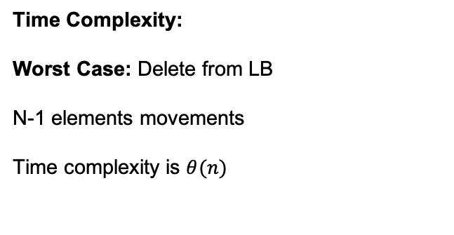
Insertion Operation on Array
Algorithm:
Repeat for j=i to UB-1
A[j]=A[j-1]
End Repeat
UB=UB-1
3 | 5 | 6 | 10 | 13 | 17 | 19 | 20
0 | 1 | 2 | 3 | 4 | 5 | 6 | 7 | 8 | 9
Time Complexity:
Worst Case: Delete from LB
N-1 elements movements
Time complexity is $θ(n)$

Slide 141
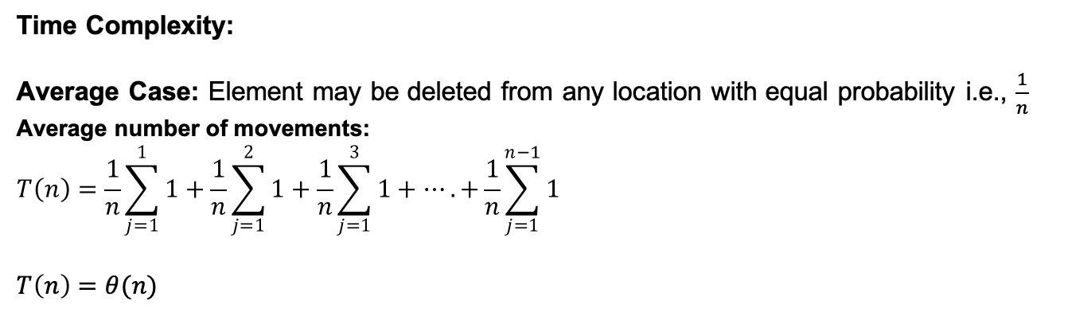
Insertion Operation on Array
Algorithm:
Repeat for j=i to UB-1
A[j]=A[j-1]
End Repeat
UB=UB-1
3 | 5 | 6 | 10 | 13 | 17 | 19 | 20
0 | 1 | 2 | 3 | 4 | 5 | 6 | 7 | 8 | 9
Time Complexity:
Average Case: Element may be deleted from any location with equal probability i.e., $\frac{1}{n}$
Average number of movements:
$$T\left(n\right)=\frac{1}{n}\sum_{j=1}^{1}{1}+\frac{1}{n}\sum_{j=1}^{2}{1}+\frac{1}{n}\sum_{j=1}^{3}{1}+….+\frac{1}{n}\sum_{j=1}^{n−1}{1}$$
$$T\left(n\right)=θ(n)$$

Slide 142
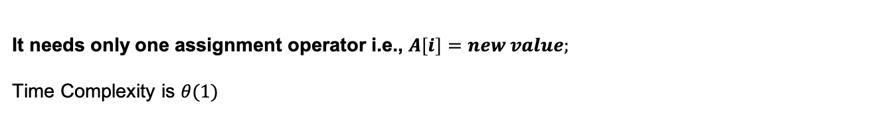
Update Operation on Array
3 | 5 | 6 | 10 | 13 | 17 | 19 | 20
0 | 1 | 2 | 3 | 4 | 5 | 6 | 7 | 8 | 9
Task: Replace the value at $i≥0$ by another value$.$
It needs only one assignment operator i.e., $A\left[i\right]=new value;$
Time Complexity is $θ(1)$

Slide 143
Putting all together
#include <stdio.h>
main(){
int n=5;
int collection[]={3, 10, 4, 6, 7};
printf(“%d”, search(A,10,n));
insert(A,15,3,&n);
delete(A, 2, &n);
display(A, n);
}
void insert(int *A,int ele,int i,int *n){
int j;
for(j=*n; j>i; j--)
A[j] = A[j-1];
A[i] = ele;
*n = *n+1;
}
void delete(int *A, int i, int *n){
int j;
for(j=i; j<*n-1; j++)
A[j] = A[j+1];
*n = *n-1;
}
int search(int A[], int ele, int n){
/* check every element in the collection */
for(i=0; i<n; i++) {
if(A[i] == ele) return i;
}
return -1;
}
void update(int *A, int i, int ele){
A[i] = ele;
}

Slide 145
Sparse Matrix
Notes:
Hello Wecome back,
We have seen how are the arrays represented in memory. In this session, we will discuss representation of a special type of array called Sparse matrix.

Slide 146
Sparse Matrix
It is a special type of matrix with a relatively high proportion of zero elements.

Slide 147
Sparse Matrix
It is a special type of matrix with a relatively high proportion of zero elements.
Some of the definitions are –
more number of zero entries than non-zero entries
matrix with more than two third zeroes entries.

Slide 148
Sparse Matrix
It is a special type of matrix with a relatively high proportion of zero elements.
Some of the definitions are –
more number of zero entries than non-zero entries
matrix with more than two third zeroes entries.
Question?
Is it necessary to store the zero entries in memory, as it is known to have zero values?

Slide 149
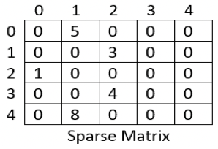
Sparse Matrix
Two Cases:
Store all the elements, including zeroes
Store only the non-zero elements
Notes:
Let us consider this example. There are many zero elements and only few non-aero elements.

Slide 150
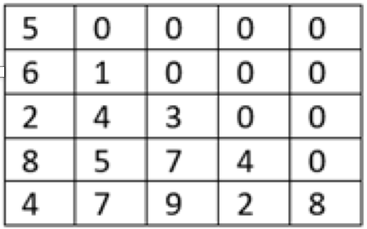
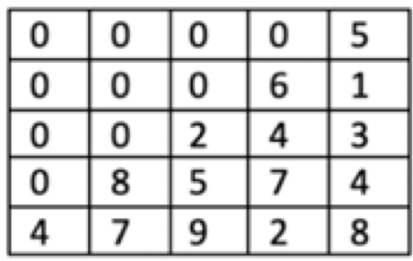
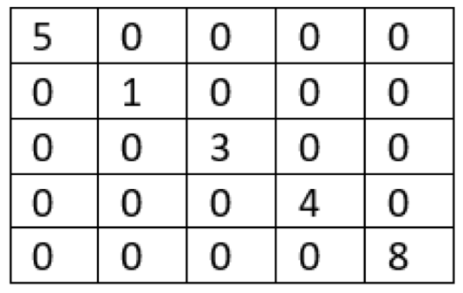
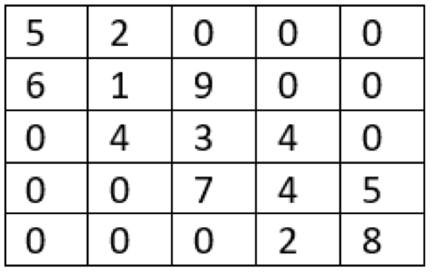
Some Special Sparse Matrix
Triangular Matrices
Diagonal and Tri-diagonal Matrices

Slide 151
Left Lower Triangular Matrix
Task: Store only the non-zero elements in memory
Memory

Slide 152
Left Lower Triangular Matrix
Task: Store only the non-zero elements in memory
Row major order
Column major order
Memory

Slide 153
Left Lower Triangular Matrix
Task: Store only the non-zero elements in memory
Row major order
Column major order
Memory

Slide 154
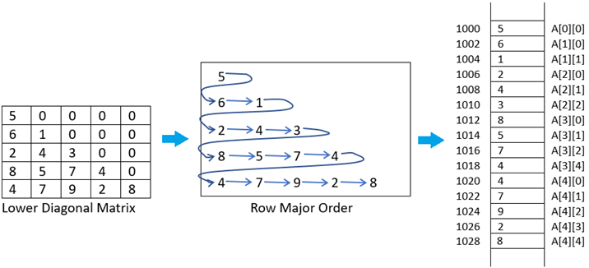
Left Lower Triangular Matrix
Task: Store only the non-zero elements in memory

Slide 155
Left Lower Triangular Matrix
Task: Store only the non-zero elements in memory
main(){
int i,j,k=0, n=5;
int B[25];
for(i=0; i<n; i++){
for(j=0; j<n; j++){
if(i>=j){
scanf(“%d”, &B[k]);
k++;
}
}
}
}

Slide 156
Left Lower Triangular Matrix
Task: Store only the non-zero elements in memory
main(){
int i,j,k=0, n=5;
int B[25];
for(i=0; i<n; i++){
for(j=0; j<n; j++){
if(i>=j){
scanf(“%d”, &B[k]);
k++;
}
}
}
}
What is the effective address of A[ i ][ j ] ?

Slide 157
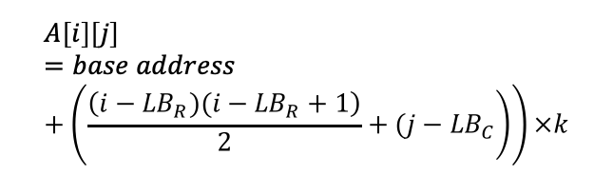
Left Lower Triangular Matrix
Task: Store only the non-zero elements in memory
$$A\left[i\right]\left[j\right]=base address+\left(\left.\frac{\left(i−{LB}_{R})(i−{LB}_{R}+1\right)}{2}+(j−{LB}_{C}\right)\right)×k$$

Slide 158
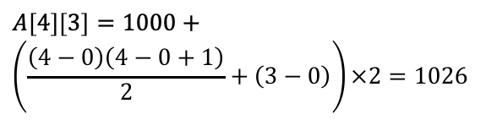
Left Lower Triangular Matrix
Task: Store only the non-zero elements in memory
$$A\left[i\right]\left[j\right]=base address+\left(\left.\frac{\left(i−{LB}_{R})(i−{LB}_{R}+1\right)}{2}+(j−{LB}_{C}\right)\right)×k$$
$$A\left[4\right]\left[3\right]=1000+$$
$$\left(\frac{\left(4−0\right)\left(4−0+1\right)}{2}+\left(3−0\right)\right)×2=1026$$

Slide 159
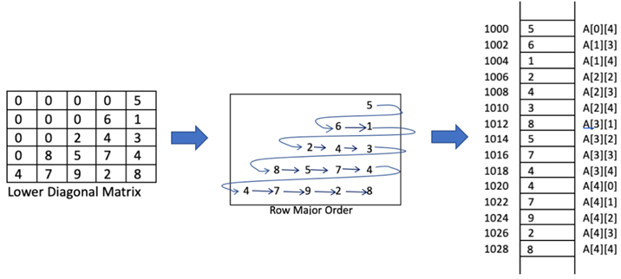
Right Lower Triangular Matrix
$$A\left[i\right]\left[j\right]=base address+\left(\frac{\left(i−{LB}_{R})(i−{LB}_{R}+1\right)}{2}+\left(\left.\left(j−{LB}_{C}\right)−{\left(UB\right.}_{R}−i\right)\right)\right)×k$$

Slide 160
Right Lower Triangular Matrix
$$A\left[i\right]\left[j\right]=base address+\left(\frac{\left(i−{LB}_{R})(i−{LB}_{R}+1\right)}{2}+\left(\left.\left(j−{LB}_{C}\right)−{\left(UB\right.}_{R}−i\right)\right)\right)×k$$
$$A\left[2\right]\left[3\right]=1000+\left(\frac{\left(2−0)(2−0+1\right)}{2}+\left(\left(3−0)−(4−2\right)\right)\right)×2=1000+(3+1)×2=1008$$

Slide 161


Diagonal Matrix
$$A\left[i\right]\left[i\right]=base address+(i−{LB}_{R})×k$$

Slide 162


Tri-Diagonal Matrix
$$A\left[i\right]\left[j\right]=base address+\left(\left.\left(i−{LB}_{R}−1\right)×3+2+(j−i+1\right)\right)×k$$

Slide 163
Tri-Diagonal Matrix
$$A\left[i\right]\left[j\right]=base address+\left(\left.\left(i−{LB}_{R}−1\right)×3+2+(j−i+1\right)\right)×k$$
$$A\left[3\right]\left[2\right]=1000+((3−0−1)×3+2+(2−3+1))×2=1016$$

Slide 164

General Sparse Matrix

Slide 166
Abstract Data Type (ADT)

Slide 167

Scenario
John, a Beginner

Slide 168
Scenario
Task: John has a task that needs to be solved using array. But, he does not know how to implement operations on array.
John, a Beginner

Slide 169

Scenario
Task: John has a task that needs to be solved using array. But, he does not know how to implement operations on array.
Bob, an Expert
John, a Beginner

Slide 170
Scenario
Task: John has a task that needs to be solved using array. But, he does not know how to implement operations on array. John requests Bob for help.
John requests Bob for help
Bob, an Expert
John, a Beginner

Slide 171
Scenario
Task: John has a problem that needs to be solved using array. But, he do not know how to implement operations on array. John requested Bob for help.
Array ADT
Bob, an Expert
John, a Beginner

Slide 172
Scenario
Task: John has a problem that needs to be solved using array. But, he do not know how to implement operations on array. John requested Bob for help.
Array ADT
Bob, an Expert
John, a Beginner

Slide 173
Bob creates Array ADT
class Array {
private:
int *A;
int n;
public:
void create(int);
int search(int);
void insert(int, int);
void delete(int);
void display(void);
};

Slide 174
Bob creates Array ADT
class Array {
private:
int *A;
int n;
public:
void create(int);
int search(int);
void insert(int, int);
void delete(int);
void display(void);
};
int Array::search(int ele){
int i;
for(i=0; i<n; i++) {
if(A[i] == ele) return i;
}
return -1;
}
void Array::insert(int ele,int i){
int j;
for(j=n; j>i; j--)
A[j] = A[j-1];
A[i] = ele;
n = n+1;
}
void Array::create(int s){
A=(int*)malloc(sizeof(int)*s);
}

Slide 175
John uses the Array ADT
main(){
Array X;
X.create(10);
X.insert(5,0);
X.insert(5,1),
….
X.display();
X.search(7);
}

Slide 176
What is an Abstract Data Type?
Abstract data type is a way of separating the implementation of a data structure, from its usage.

Slide 177
What is an Abstract Data Type?
Abstract data type is a way of separating the implementation of a data structure, from its usage.
Bob, Implementer
John, Client

Slide 178
What is an Abstract Data Type?
Primitive data types and the traditional data structures
Define data from the perspective of storage and organization
Implement of everything – storage, organization, operations
You have to be both the implementer as well as the client
Abstract data type
Defines data from the point of view of the users of the data - possible values, possible operations, and functionality of the operations.
Implementer develops the ADT, and Client uses the ADT in the form of plug-and-play

Slide 179
Abstract Data Type
class Array {
private:
int *A;
int n;
public:
void create(int);
int search(int);
void insert(int, int);
void delete(int);
void display(void);
};

Slide 180
Abstract Data Type
class Array {
private:
int *A;
int n;
public:
void create(int);
int search(int);
void insert(int, int);
void delete(int);
void display(void);
};
Members:
Member data
Member functions

Slide 181
Abstract Data Type
class Array {
private:
int *A;
int n;
public:
void create(int);
int search(int);
void insert(int, int);
void delete(int);
void display(void);
};
Members:
Member data
Member functions
Access Specifiers:
Private
Public

Slide 182
Abstract Data Type
class Array {
private:
int *A;
int n;
void foo(..);
public:
int B;
void create(int);
int search(int);
void insert(int, int);
void delete(int);
void display(void);
};
Members:
Member data
Member functions
Access Specifiers:
Private
Public

Slide 183
Abstract Data Type
class Array {
private:
int *A;
int n;
public:
void create(int);
int search(int);
void insert(int, int);
void delete(int);
void display(void);
};
main(){
Array X;
X.create(10);
X.insert(5,0);
X.insert(5,1),
….
X.display();
X.search(7);
}
Client
Implementer

Slide 184

Abstract Data Type

Slide 185
Abstract Data Type
Properties:
Encapsulation
Data Hiding
Inheritance

Slide 186
Abstract Data Type
Advantages:
Client uses ADT without knowing internal implementation details
Implementer can update the ADT without affecting the client program

